Slide 1
Multi-scale correction of optical diffusion in X-ray tomography
HIGH-PERFORMANCE
ALGORITHMS FOR
TOMOGRAPHY
Rana Alouani
ESRF - Summer internship 2026
Supervisor: Alessandro Mirone
Central question
How can we correct the diffusion halo without paying the computational cost of the full correction?
Notes:
Good morning. During this internship at the ESRF, I worked on high-performance algorithms for tomography, and more specifically on the correction of optical diffusion in tomography projections. The problem is that this diffusion produces a spatially extended halo in the measured projections. We already have a correction method, but applying the full correction everywhere and for every projection is computationally expensive. So the question I investigated was: how can we preserve the correction while reducing its computational cost? The approach I will present is based on separating the correction into different spatial scales. : je blabla un peu trop : check encore une fois pour raccourcir

Slide 2

Where does the diffusion come from?
From X-rays to the measured projection
X-rays
Scintillator
Visible light
Camera
I_meas: measured detector projection
I_ideal: ideal projection before optical diffusion
K: spatial diffusion kernel
∗: convolution operator
Light generated in the scintillator spreads before reaching the detector.
Notes:
In tomography, the detector does not directly record the incoming X-rays. The X-rays are first converted into visible light inside a scintillator, and this light is then recorded by the camera.But the light does not remain perfectly localized. Part of it propagates inside the scintillator before reaching the camera. Mathematically, we can describe the measured image as the ideal projection convolved with a diffusion kernel K. So before thinking about acceleration, the first thing we need to understand is: what does this kernel actually look like?

Slide 3

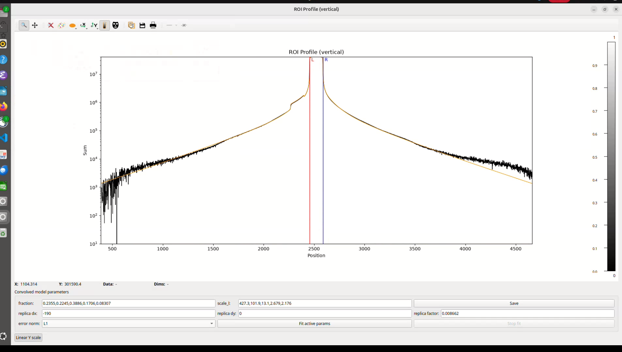
The diffusion is multi-scale
Several characteristic spatial lengths coexist in the same kernel
ADD FIGURE
Real-space diffusion kernel — logarithmic scale
r : distance from the kernel center
Sᵢ : characteristic diffusion length of component i
Fᵢ : weight / fraction of component i
δ(r): direct, non-diffused contribution
Short range → local variations
Long range → extended halo
Vertical profile of the real-space diffusion kernel ( logarithmic scale )
Notes:
This is what the diffusion kernel actually looks like. The central peak corresponds to the direct response, but around it we have several exponentially decaying components with different characteristic lengths. In the model, each component has a scale s(I) à and a weight f(I) . Therefore the diffusion is intrinsically multi-scale. On a linear scale, almost everything disappears because the central peak dominates. This is why I show the kernel here on a logarithmic scale. The important observation is that some components are very localized, while others extend over much larger distances. This observation is what motivates the rest of the work.

Slide 4

Why is the full correction expensive?
Reference approach: full-resolution deconvolution
Î: Fourier transform
I_corr: corrected projection
I_meas: measured projection
K̂: diffusion kernel in Fourier space
Padding
FFT
Divide by K̂
Inverse FFT
Crop
The full correction processes large projections at full spatial resolution, even though part of the correction varies only slowly.
Notes:
The existing correction is performed through deconvolution. After padding the projection, we compute its Fourier transform, divide by the Fourier transform of the diffusion kernel, and transform the result back to real space. This works, but it means processing full-resolution projections with large FFTs. And this is where the multi-scale structure becomes interesting. If part of the correction varies slowly over space, do we really need to compute that part at full resolution everywhere? This leads to the central idea of the project : bon je ne sais pas trop si je dis ça comme ça ...

Slide 5

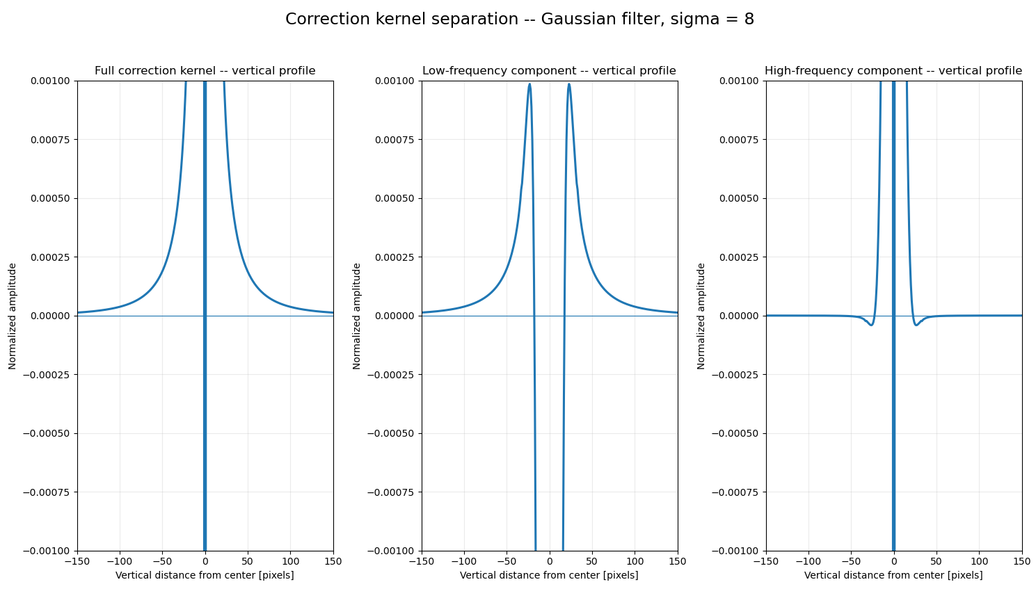



Separate low and high spatial frequencies
The correction is decomposed into a smooth global part and a detailed local part
ADD FIGURE
kernel_correction_low_high_sigma8_ZOOM.png
Q: diffusion correction
Q_LF: low-frequency part
Q_HF: high-frequency part
Gσ: Gaussian filter
σ: Gaussian width
∗: convolution
σ = 8 pixels
LF: smooth + extended
HF: detailed + localized
Display ranges are adapted per panel so the weaker HF component remains visible; colors are not a common amplitude scale.
Correction kernel decomposition into low- and high-frequency components using a Gaussian filter (σ=8). The low-frequency component captures the spatially extended contribution, while the high-frequency component retains the localized structures.
Notes:
Instead of treating the correction as one object, I separate it into a low-frequency and a high-frequency contribution. I define the correction Q as the difference between the measured signal and the fully corrected signal. The low-frequency component is obtained by Gaussian filtering with sigma equal to eight pixels. The high-frequency component is simply what remains. So by construction, low plus high gives back exactly the original correction. This figure shows the same decomposition applied to the correction kernel . Now the computational strategy becomes clear: treat the smooth component cheaply, and exploit the locality of the high-frequency component.

Slide 6


Why can the low-frequency part be cheaper?
A smooth field can be represented with fewer spatial samples
Second observation :
b: spatial binning factor
Nₓ, Nᵧ: original image dimensions
The low-frequency correction also changes slowly between nearby projections.
spatial bin = 4
→ This suggests reducing the angular sampling as well.
≈ 16× fewer spatial samples
Data reduction ≠ measured end-to-end speed-up. A final speed-up requires benchmarking the complete implementation.
Notes:
The first optimization concerns spatial resolution. Because the low-frequency correction is smooth, we can bin it spatially before processing it. With a spatial bin of four in both dimensions, the number of spatial samples is divided by sixteen.
With a Gaussian separation at sigma equals eight pixels, the low-frequency structures are already smooth over several pixels. After a spatial binning by four, this characteristic scale still corresponds to about two pixels in the reduced image. So we significantly reduce the data size without removing the low-frequency information we want to keep.
I want to be precise here: this does not automatically mean that the complete algorithm is sixteen times faster. It only tells us how much the spatial data size is reduced. The actual speed-up depends on the complete implementation and on the FFT cost. But spatial binning is only one possibility. The low-frequency correction also changes relatively slowly from one projection to the next, which suggests a second reduction.

Slide 7
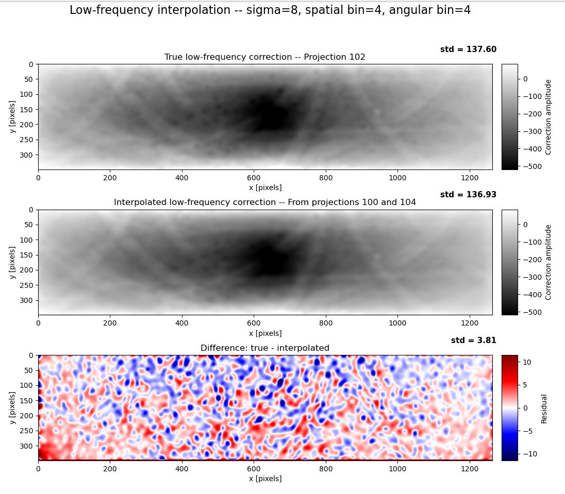

We do not need the LF correction for every projection
Predict projection 102 from two nearby corrected projections
ADD FIGURE
Low-frequency interpolation figure — σ=8, spatial bin=4, angular bin=4
Projection 100
Projection 102
Projection 104
t=(102−100)/(104−100)=1/2: interpolation weight
Cᵢ: beam-current normalization for projection i
Q_LF(i): LF correction of projection i
Residual fluctuations are small compared with the LF correction : std(true LF) = 137.6 std(interpolated LF) = 136.9 std(residual) = 3.81 → residual std ≈ 2.8% of true-LF std
Low-frequency correction at projection 102, predicted from projections 100 and 104 using spatial binning ×4 and angular interpolation ×4. The residual (right) is displayed with a symmetric diverging scale centered at zero.
Notes:
Here I combine spatial and angular reduction. Instead of calculating the low-frequency correction for projection 102 directly, I calculate it for projections 100 and 104, spatially bin these corrections by four, and interpolate between them. The interpolation also includes a normalization by the projection current, because the overall intensity can change between projections. On the left is the true low-frequency correction for projection 102. In the center is the prediction obtained from 100 and 104. Visually, the large-scale structures are very similar.
On the right I show their difference. Here I use the seismic color map: red and blue represent positive and negative errors, and white corresponds approximately to zero
. Its standard deviation is only 3.8, compared with about 138 for the low-frequency correction. So although the colors make the residual look significant, its fluctuations are actually much smaller.
This establishes that the smooth component can be approximated using both spatial and angular subsampling.

Slide 8

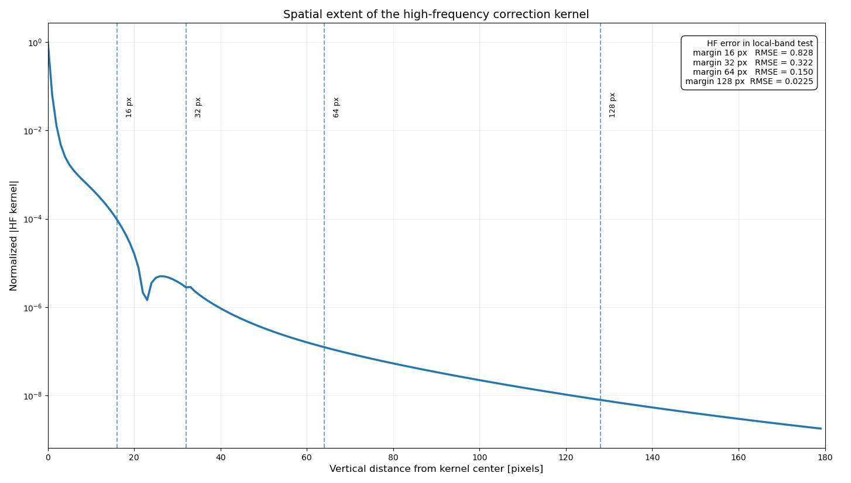
The high-frequency part is local
Fine spatial details must be preserved, but they do not require the full projection height
ADD FIGURE
HF_kernel_vertical_profile_sigma8_FINAL.png
Q_HF: local high-frequency correction
Q: total correction
Q_LF: smooth low-frequency correction
HF amplitude decreases rapidly with distance from the kernel center.
Normalized vertical HF-kernel profile. Tested margins: 16, 32, 64, 128 px. HF RMSE: 0.828 → 0.322 → 0.150 → 0.0225.
Notes:
The second part of the strategy concerns the high-frequency correction . Unlike the low-frequency component, we cannot strongly bin the high-frequency part because it contains the fine structures. But we can exploit something else: its spatial locality....This plot shows the normalized magnitude of the high-frequency correction kernel as a function of vertical distance from its center, on a logarithmic scale. The amplitude drops by several orders of magnitude as we move away from the center...I then tested different local margins around the region that actually needs to be corrected... With 16 pixels, the high-frequency RMSE is about 0.83. At 32 pixels it drops to 0.32, at 64 pixels to 0.15, and at 128 pixels to about 0.0225....So we do not need the full projection height to recover the high-frequency contribution accurately. A relatively local neighbourhood already captures most of it.

Slide 9

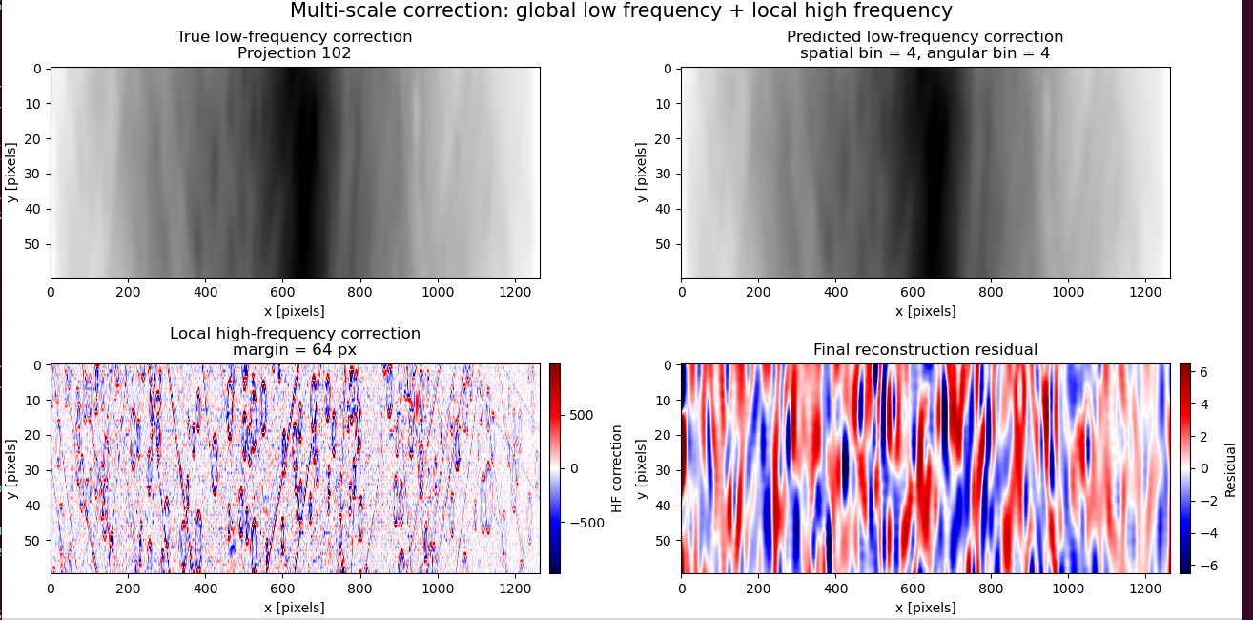

Combine both approximations
Global low frequency + local high frequency
ADD FIGURE
FINAL_pipeline_multiscale_margin64.png
Q_LF,pred: binned + angularly interpolated LF term
Q_HF,local: HF term computed on the local band
I_corr,approx: final approximate corrected projection
σ = 8
spatial bin = 4
angular bin = 4
HF margin = 64 px
Combined multi-scale correction: spatially and angularly interpolated low-frequency contribution combined with a local high-frequency correction using a 64-pixel margin. The final residual is shown relative to the full-reference correction.
Notes:
We can now put the two approximations together. The top-left image is the true low-frequency correction for projection 102, while the top-right image is our low-frequency prediction obtained with spatial bin four and angular bin four . The bottom-left panel contains the high-frequency correction computed only locally, here using a 64-pixel margin. Adding these two contributions gives our approximation of the complete correction. The bottom-right panel shows the final residual relative to the reference. Notice something important: the residual is much smoother than the high-frequency component. This is consistent with the quantitative results. At a margin of 64 pixels, the high-frequency localization error has an RMSE of only about 0.15, whereas the final reconstruction error is around 2.23. Therefore, at this point, the limiting contribution is no longer the localization of the high-frequency correction. The remaining error is mainly associated with the approximated low-frequency prediction.

Slide 10
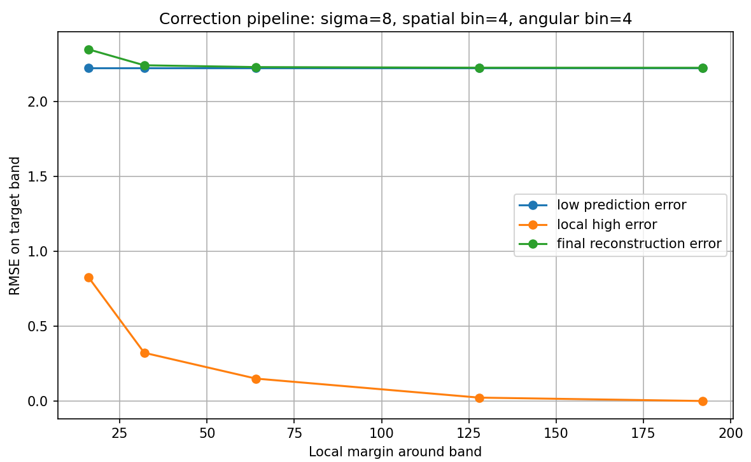
Where is the remaining error?
Once HF is sufficiently localised, the bottleneck shifts to the LF approximation
HF margin | HF RMSE | Final RMSE
16 px | 0.828 | 2.349
32 px | 0.322 | 2.243
64 px | 0.150 | 2.231
128 px | 0.0225 | 2.226
192 px | 0 | 2.226
ADD FIGURE
23_full_correction_spatial4_angular4_local_high_metrics.png
As the HF error approaches zero, the final RMSE saturates near the LF prediction error (~2.23).
Beyond ~64–128 px, increasing the HF margin brings little improvement to the final error.
Notes:
This quantitative result is useful because it tells us where further optimization effort should go. Increasing the high-frequency margin strongly improves the high-frequency approximation itself. The RMSE decreases from 0.83 at 16 pixels to essentially zero when the full available region is used. But the final reconstruction RMSE quickly saturates around 2.23. This value is very close to the low-frequency prediction error, which was approximately 2.226 in this band test. So once the high-frequency margin is large enough, increasing it further provides almost no improvement to the final result. In other words, the bottleneck has shifted: the high-frequency localization works; the next improvement should target the low-frequency approximation.
This separation also changes where the correction can be applied in the reconstruction pipeline. Previously, the full diffusion correction had to be performed before digest creation because of its large spatial extent. With the new approach, only the long-range low-frequency component remains outside the digest, since it requires information over a large part of the radiograph. The high-frequency component is local enough to be applied directly during volume processing, within the reading margin

Slide 11
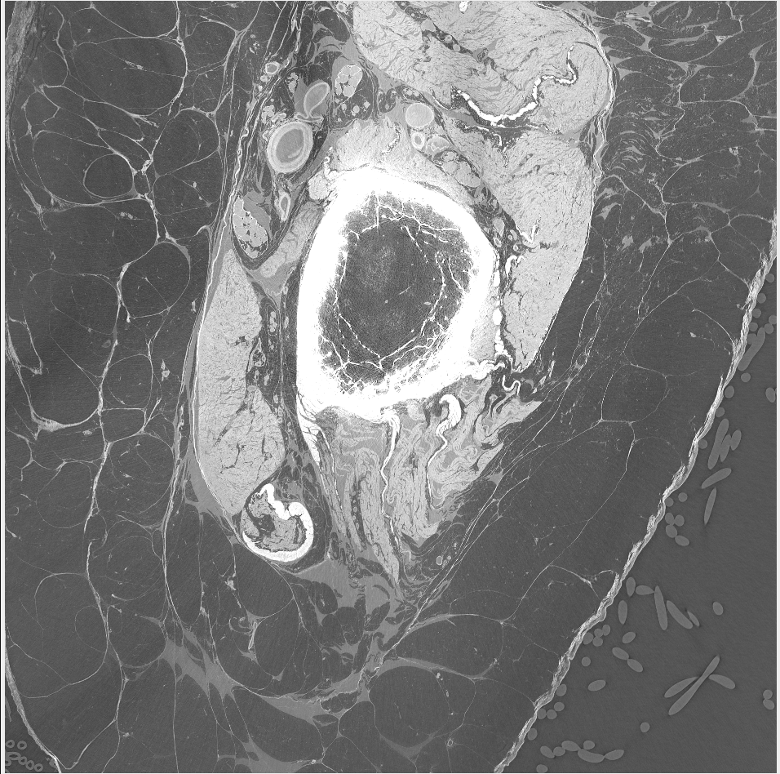
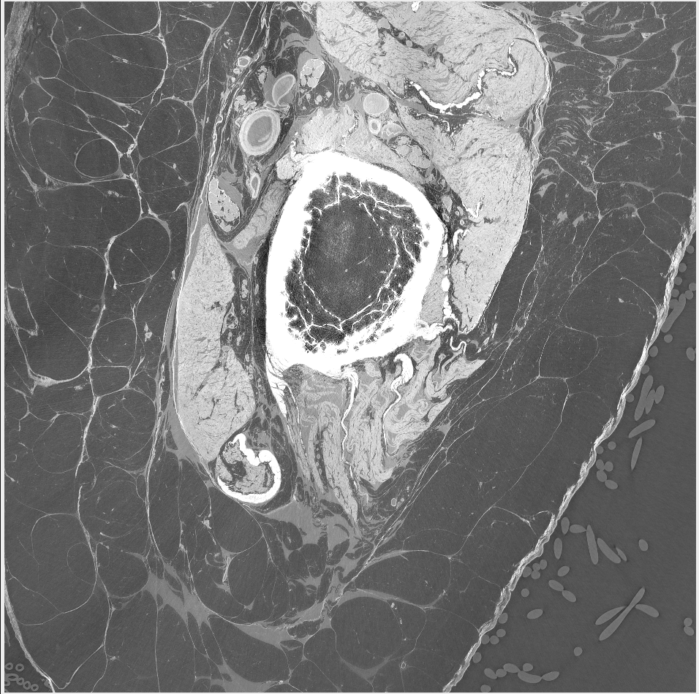
Final visual check on experimental reconstruction
Validation on reconstructed data
Notes:
Finally, I want to show the effect directly on the reconstructed tomography.
Here, all images show the same reconstructed slice with the same crop and the same grayscale range so they can be compared directly.
First, in the left image there is no deconvolution. This gives us the reconstruction before correcting the optical diffusion.
In the right image, I apply only the low-frequency correction. We already recover part of the effect, but this correction intentionally contains only the smooth, long-range contribution.

Slide 12
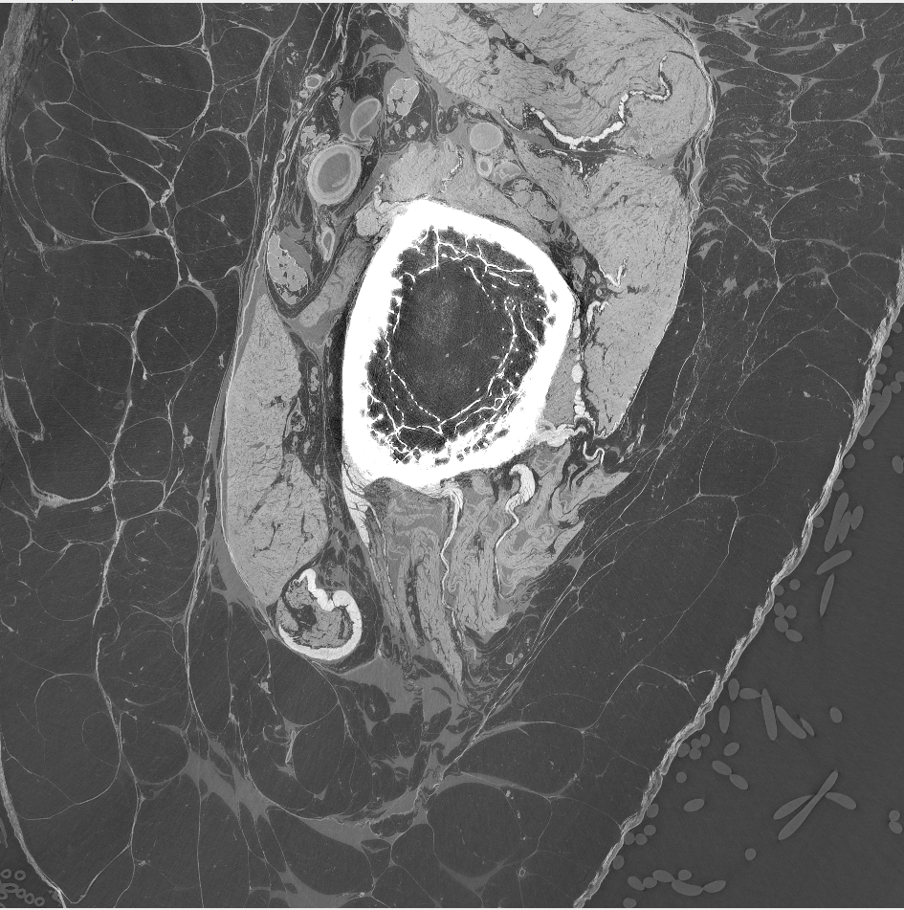
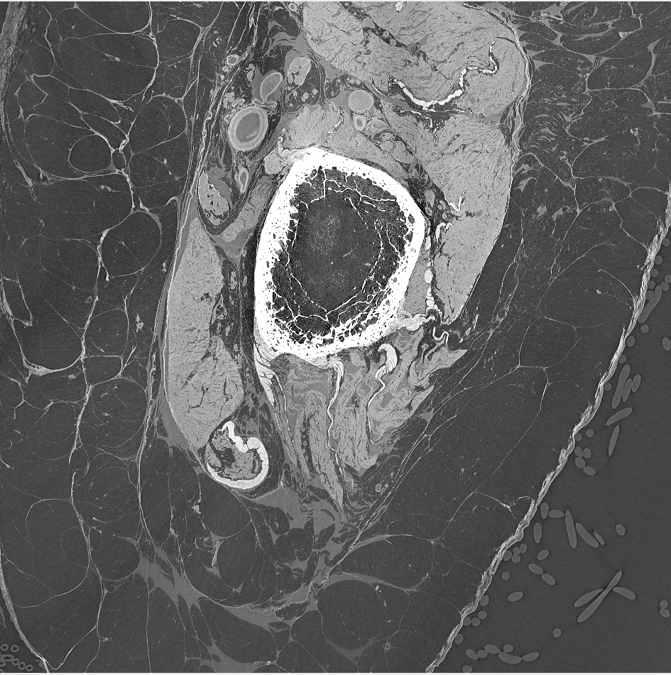
Notes:
In the right image, we have the new correction developed during the internship: the low-frequency contribution is treated at reduced spatial and angular resolution, and the local high-frequency contribution is added separately = final reconstruction

Slide 13
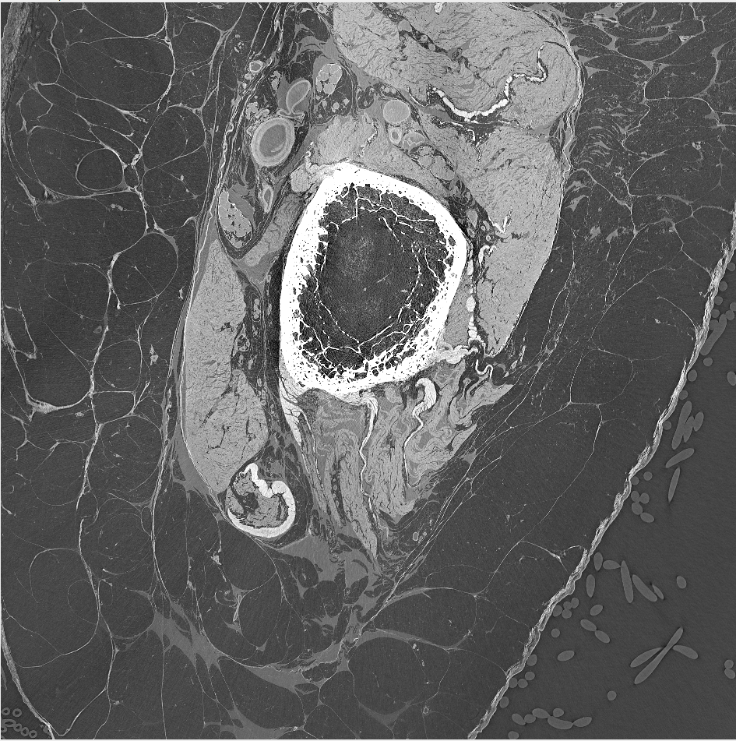
Notes:
Finally, in the left image we have the previous full-resolution correction, which is used here as the reference.
The important comparison is therefore between these two images. The goal of the new method is to reproduce the effect of the reference correction while avoiding the computational and storage cost of applying the complete correction everywhere at full resolution.
Visually, the new LF plus HF reconstruction remains very close to the reference.
So once we know that the correction remains visually consistent with the reference, the final question is: what do we actually gain in terms of storage and processing time?

Slide 14
Measured performance gains
DISK FOOTPRINT
DIGEST CREATION
RECONSTRUCTION
4.7 TB → 80 GB
32 min → 4 min
118 min → 93 min
≈ 59× smaller
8× faster
−25 min
98.3% reduction
87.5% less time
≈ 21.2% less time
Measured final gains
4.7 TB / 80 GB ≈ 59
32 / 4 = 8
(118−93)/118 × 100 ≈ 21.2%
12
Notes:
The performance gains are also significant. The disk footprint decreases from 4.7 terabytes to about 80 gigabytes, which is approximately 59 times smaller. Digest creation decreases from 32 minutes to 4 minutes, so it is about eight times faster. And the reconstruction time decreases from 118 minutes to 93 minutes, which is a reduction of about 21 percent. These measurements show that the multi-scale strategy improves not only the numerical organization of the correction, but also the practical cost of the reconstruction pipeline.

Slide 15
Comments after presentation :
Model is Linear : seperation of Lf and Hf.
Add pipeline recap : steps ==> diff from previous pipeline
Doffusion + problem of corre of nighb pixels
Diffusion comes from SENSOR !!!!
Optical ghoste : LENS !!!
From high resolution x rays ( low wavelenghts ) ====> visible light : we introduce some degradation
Why diffusion and what exactly it is

